Slide 1
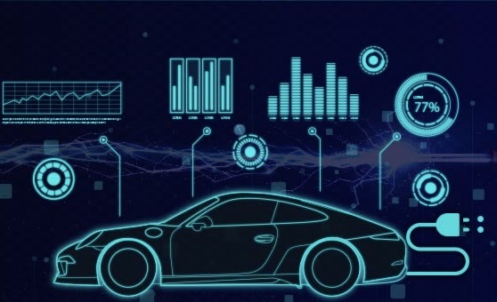
ElectraInsight:Data Analysis for EV

Slide 2
